Slide 1
Herhackathon 2021- Mercedes benz
By Team Ada Lovelace (7 team members)
Amalia Pita de Veiga - Maria Tirlea
Cindy Pritami Putri - Paola Moreno
Hazel Wat (speaker) - Rita Trindade
Jayde Pearson (speaker – Q&A)

Slide 2
Challenge Presentation Metric #4 – Accessibility
Key questions:
What makes the code sustainable?
How to improve accessibility?
Web accessibility is a set of rules, behaviors, code standards and design guidelines of how a website should operate.

Slide 3
Challenge Presentation Metric #4 – Accessibility
Approach:
Combine open source resources
Generate report
Show its accessibility (Goods and Bads)
Developers:
Issues to fix
Maintainable by others?
Users:
User input options

Slide 4
Challenge Presentation Metric #4 – Accessibility
Differentiate between user and developer
i. 3 inputs from UI
URI
File Upload
Direct Input
ii. Computer accessibility
Web accessibility using WCAG 2.1 requirement
to accommodate disbilities such as blind or motor-impaired

Slide 5
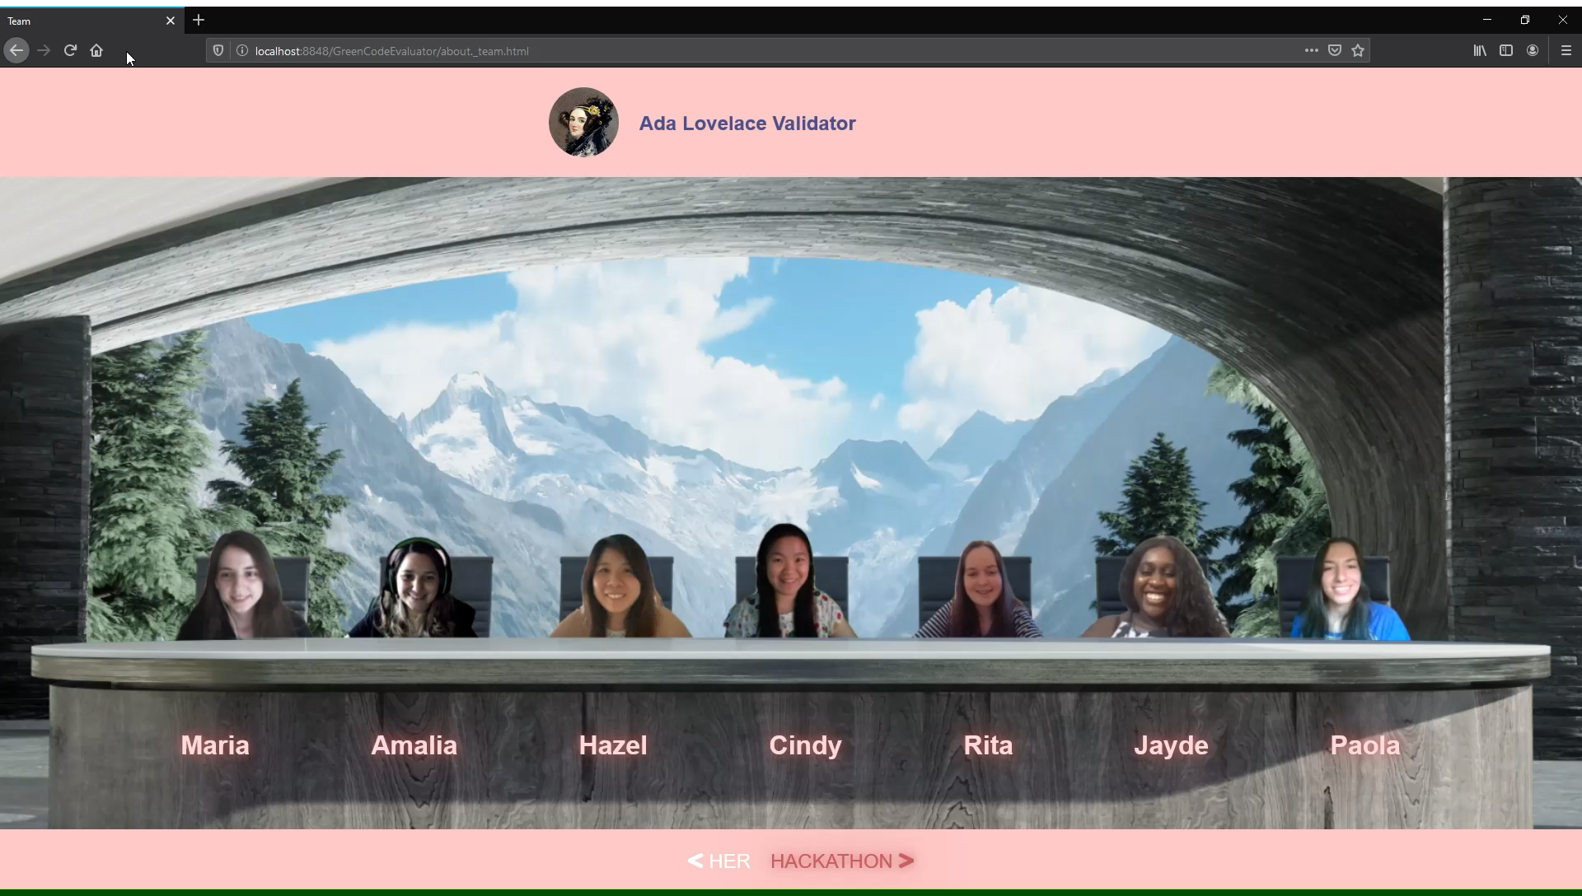
Challenge Presentation Metric #4 – Accessibility
Demo

Slide 6
Challenge Presentation Metric #4 – Accessibility
Thank you!
Q & A

